Slide 1
IOTA Community Logo
IOTA
The distributed communication layer of tomorrow

Slide 2


DISCLAIMER:
NO FINANCIAL ADVICE WILL BE GIVEN IN THIS PRESENTATION
Notes:
Still relevant until Dan gives financial guidelines about the Token

Slide 3
Index
whoami/whoarewe
IOTA Libraries
The IOTA Foundation
Use Cases
What today is about

Slide 4
Index
whoami/whoarewe
IOTA Libraries
The IOTA Foundation
Use Cases
What today is about

Slide 5


whoami/whoarewe
Name Surname
Your Title - yourwebsite.com
Following distributed ledger technology since 2011
Love free and open source software
Project with local company
Notes:
Present the organizers, speakers, supporters
Examples:
Your title, your line of work
what you do
when you started following IOTA

Slide 6
whoami/whoarewe
Name Surname
Your Title - yourwebsite.com
Following distributed ledger technology since 2011
Love free and open source software
Project with local company
Notes:
Present the organizers, speakers, supporters
Examples:
Your title, your line of work
what you do
when you started following IOTA

Slide 7
whoami/whoarewe
Name Surname
Your Title - yourwebsite.com
Following distributed ledger technology since 2011
Love free and open source software
Project with local company
Notes:
Present the organizers, speakers, supporters
Examples:
Your title, your line of work
what you do
when you started following IOTA

Slide 8




Technology
Governance
Ecosystem
Notes:
Important Puzzle Pieces
The Tangle and IOTA technology
The Governance by the IOTA Foundation
The Ecosystem around IOTA

Slide 9

The Tangle
The Tangle is the immutable data structure that contains a history of IOTA transactions.
Notes:
The Tangle is the immutable data structure that contains a history of IOTA transactions. All nodes in an IOTA network store a copy of the Tangle in their ledgers and can read from it and attach new transactions to it.
This removes completely the need to pay fees to miners and thus opens up the possibility to execute microtransactions which could be worth as little as a few cents.
Besides, IOTA’s DAG data structure allows for the network’s easy scalability. Everyone is participating in reaching a consensus and, therefore, the more people are using IOTA, the faster the network becomes.

Slide 10

The Tangle
The unique data structure being utilized in IOTA
Directed Acyclic Graph (DAG)
Scalable distributed framework for transactions
Transactions can hold data, value or both
Consensus
Notes:
DAG - The references among transactions form a type of directed acyclic graph (DAG), which is a sequence of vertices where every edge is directed from an earlier point to a later one in the sequence (the animation shows the three dimensional version)
Scalability - When a node attaches a new transaction to the Tangle, that transaction directly references two existing ones (make a simple multiplication to show how numbers grow)
Consensus - Network nodes are responsible for validating transactions and their histories to make sure that they don't conflict.
When a node has a transaction's entire history, the transaction is considered solid, which means that it can be considered for confirmation.
Resources for the speaker:
https://docs.iota.org/docs/dev-essentials/0.1/concepts/the-tangle

Slide 11
IoT Projects
The Internet of Things (IoT) is an umbrella term for billions of Internet-connected devices that share data with each other.
Thanks to this data-sharing network, IoT is becoming the driving force in creating more efficient communication across many aspects of our lives.
IOTA allows these devices to use the Tangle as a single source of truth, where they can buy, sell, or simply send data among each other for zero fees.
Notes:
The Internet of Things (IoT) is an umbrella term for billions of Internet-connected devices that share data with each other. Thanks to this data-sharing network, IoT is becoming the driving force in creating more efficient communication across many aspects of our lives. IOTA allows these devices to use the Tangle as a single source of truth, where they can buy, sell, or simply send data among each other for zero fees.

Slide 12
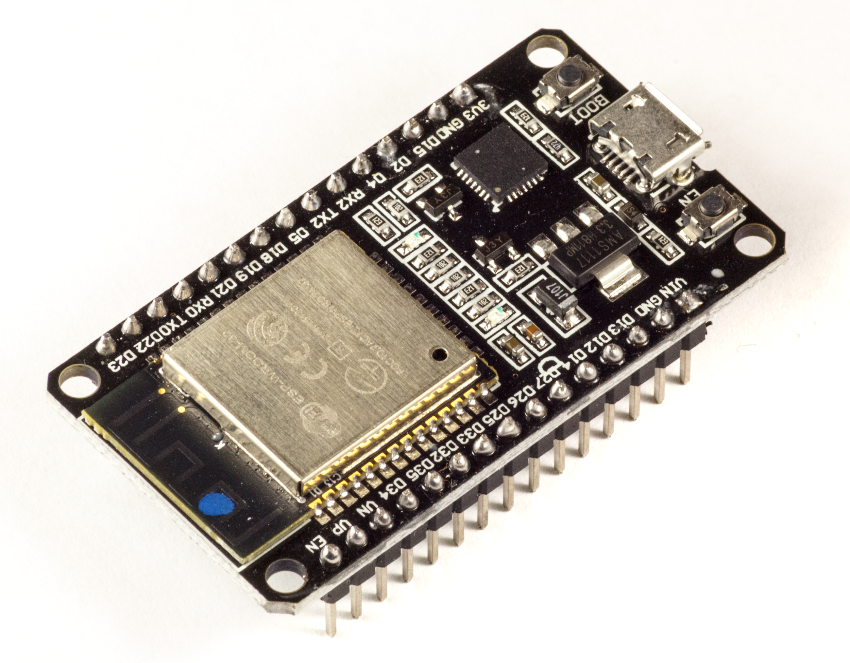
ESP32
The ESP32 is a WiFi-compatible microcontroller that also support Bluetooth Low Energy (BLE)
WiFi development board used in handmade IoT projects
Bluetooth capabilities
~32 I/O pins
Powerful 32 bit dual core CPU
Notes:
In the picture: ESP32 development board
ESP32 microcontrollers are an ideal solution for applications that need to connect to WiFi or Bluetooth.
Resources for the speaker:
https://docs.iota.org/docs/iot/0.1/esp32/introduction/get-started

Slide 13
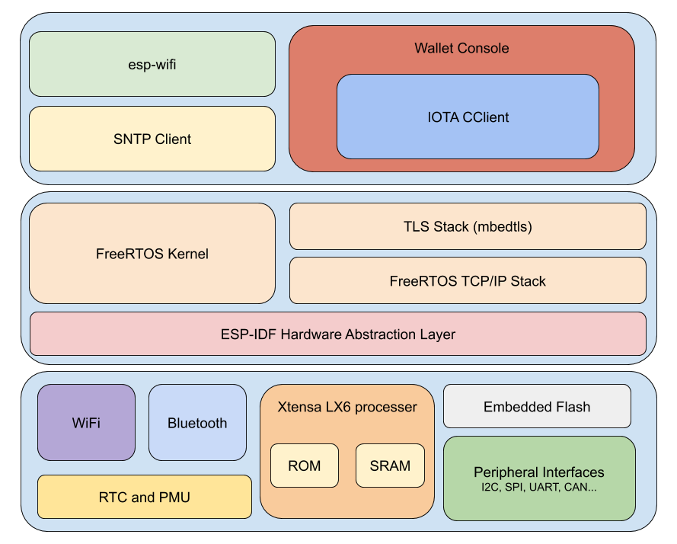
Command-line wallet on an ESP32
Notes:
An IOTA wallet that allows you to send transactions from the command-line on an ESP32
Resources for the speaker:
https://docs.iota.org/docs/iot/0.1/esp32/iota-projects/create-a-wallet

Slide 14
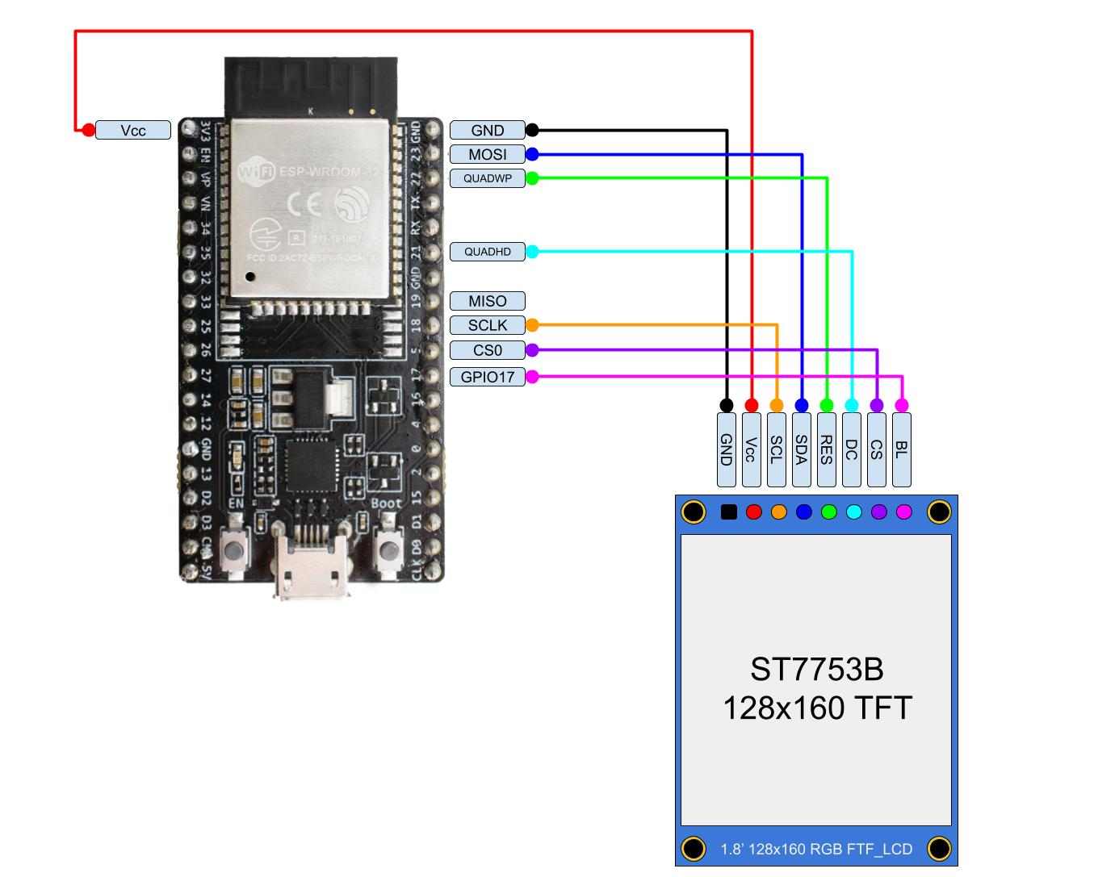
Address monitor on an ESP32
Notes:
A cashier application that allows you to display the QR code for an address on an LCD screen. This application can also monitor the balance of the address and generate a new one if IOTA tokens are ever withdrawn from it.
Resources for the speaker:
https://docs.iota.org/docs/iot/0.1/esp32/iota-projects/generate-address

Slide 15
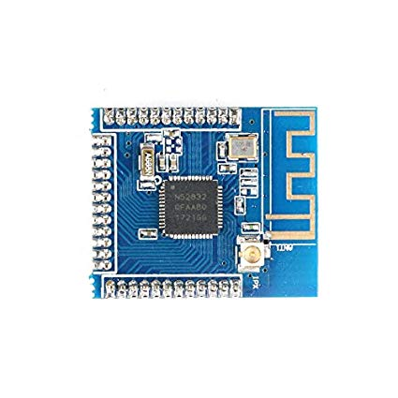
nRF52 Nordic Semiconductor
The nRF52 is power-efficient series of microcontrollers that supports Bluetooth Low Energy (BLE),
Low-power wireless solutions
Notes:
The nRF52-series of microcontrollers are an ideal solution for wearables, toys, smart home devices and appliances, and wireless charging. We use this series of microcontrollers because they include Bluetooth and are usually cheap.
Resources for the speaker:
https://docs.iota.org/docs/iot/0.1/nrf52/introduction/get-started

Slide 16
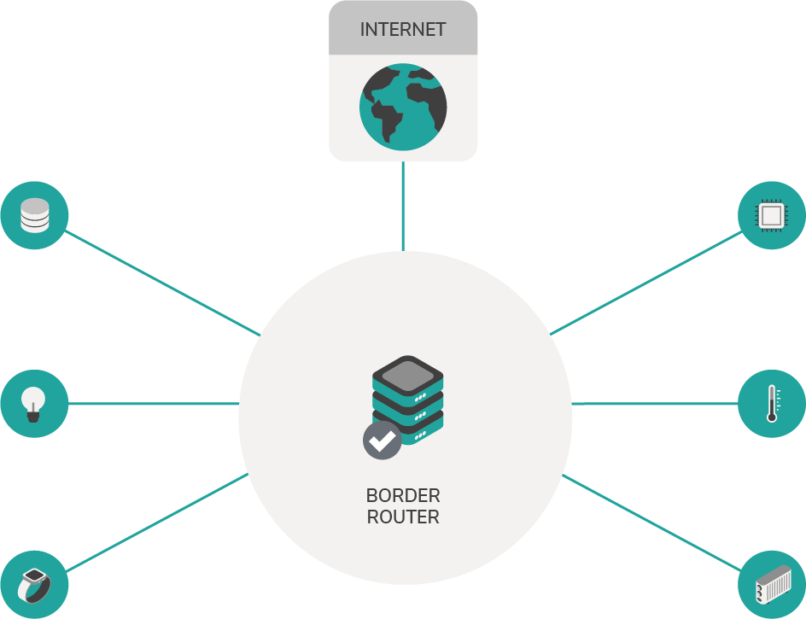
Bluetooth star network
Star networks are useful for setting up sensor server networks that communicate through a border router.
6LoWPAN over Bluetooth Low-Energy star network, using state-of-the-art IoT industry standards.
Notes:
Resources for the speaker:
https://docs.iota.org/docs/iot/0.1/nrf52/how-to-guides/set-up-a-bluetooth-star-network
6LoWPAN: https://en.wikipedia.org/wiki/6LoWPAN

Slide 17
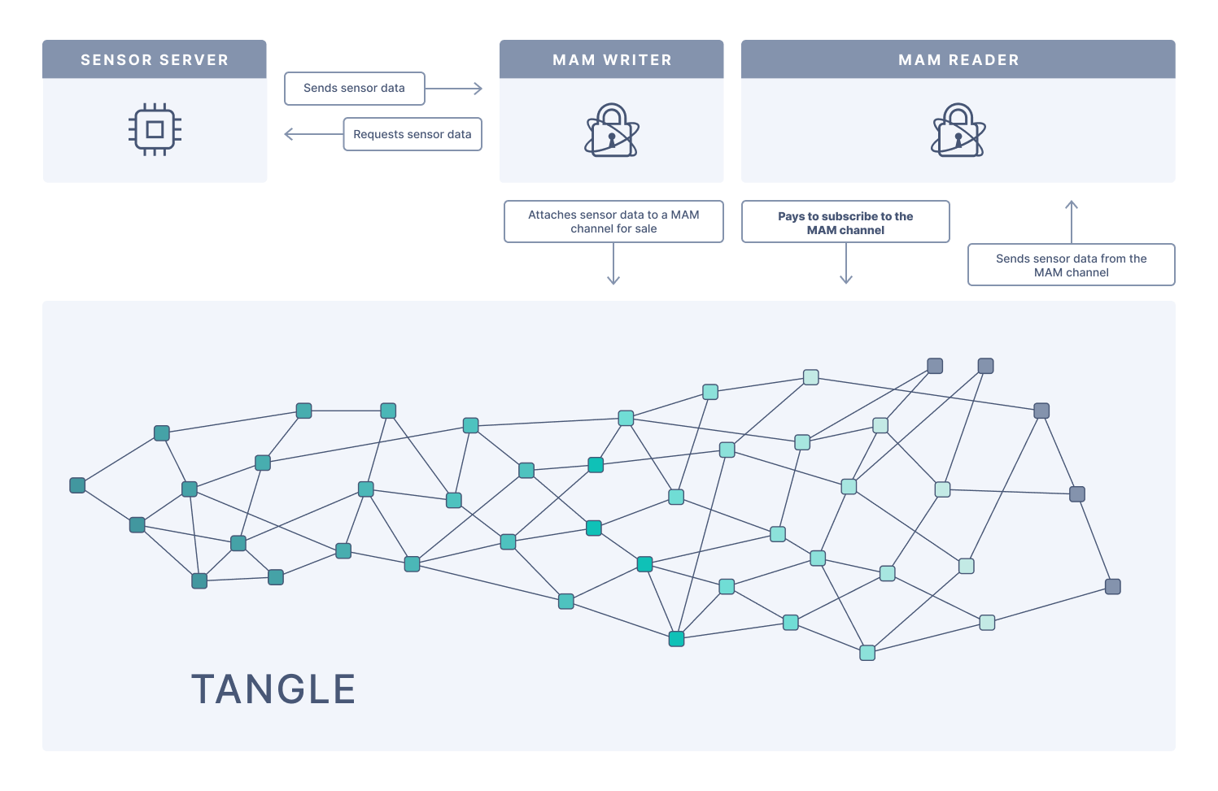
Attach sensor data to the Tangle
Notes:
An application that collects environment sensor data and attaches it to the Tangle using Masked Authenticated Messaging (MAM).
The border router asks the sensor server for information, then sends that information to a node so that it can attach it to the Tangle.

Slide 18
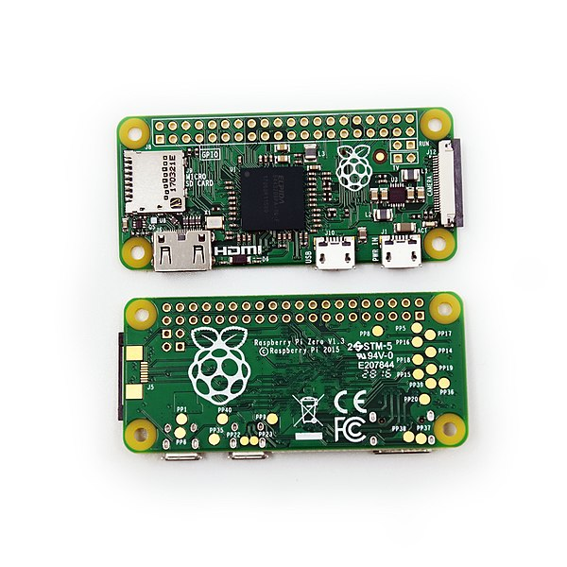
SBC (Single Board Computer)
Single-board computers (SBCS) are useful for building applications that require more power than a microcontroller.
Lighter
Smaller
Power efficient
Notes:
A single-board computer (SBC) is a small computer in which a single circuit board includes memory, input/output ports, a microprocessor and any other necessary features. SBCs are lighter, more compact, more reliable, and more power efficient than multi-board computers such as desktops.
Different projects are using SBC, you can find them on https://hackster.io/IOTA or https://ecosystem.iota.org
Resources for the speaker:
https://docs.iota.org/docs/iot/0.1/sbc/introduction/get-started

Slide 19
App Blueprints
Application blueprints explain how you can use IOTA to solve real-world problems and to support well-defined business needs.
Blueprints are designed to do the following:
Describe a problem and a solution
Present an architecture that shows you how to solve the problem with IOTA
Explain how you can test, edit, and deploy the blueprint
Notes:
App Blueprints are open source

Slide 20
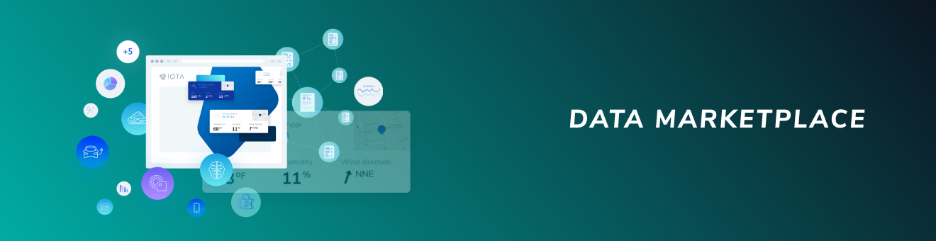
Data Marketplace
Exchange data
Monetise data streams
Empower organisations to shape their own IOTA-enabled data marketplace
Provide the basis of new smart business models
New wave of value creation, for the Internet of Everything, as the Economy of Things.
Notes:
Data silos make it difficult to buy and sell data among different data points. To overcome this challenge, the Data Marketplace uses Masked Authenticated Messaging (MAM) channels to open up the data silos and allow users to make micropayments of IOTA tokens to the data owners in exchange for data.
Resources for the speaker:
https://docs.iota.org/docs/blueprints/0.1/data-marketplace/overview
https://blog.iota.org/iota-data-marketplace-cb6be463ac7f
https://blog.iota.org/iota-data-marketplace-tech-intro-d54b29774f1a-d54b29774f1a
https://www.youtube.com/watch?v=fqdZSafCRhM

Slide 21
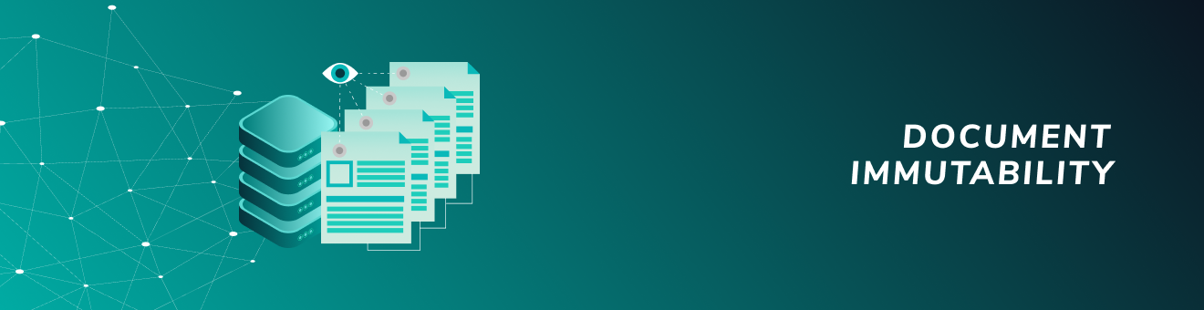
Document Immutability
Trusted and transparent way to verify document immutability
Tool to automatically check the downloaded files from a trusted source (the Tangle)
Alert the user if the files have been tampered with
Notes:
Documents are an important means of transporting information and contracts between parties. Being able to reliably prove that a document has not been changed from an established state helps ensure trust between parties. As well as protect the parties. This blueprint describes a solution that automatically checks the signature of a previously signed document using the IOTA Tangle.
Provides value and incentive for the end user to use a software that makes it easy to test the document signature.
Resources for the speaker:
https://docs.iota.org/docs/blueprints/0.1/doc-immutability/overview

Slide 22
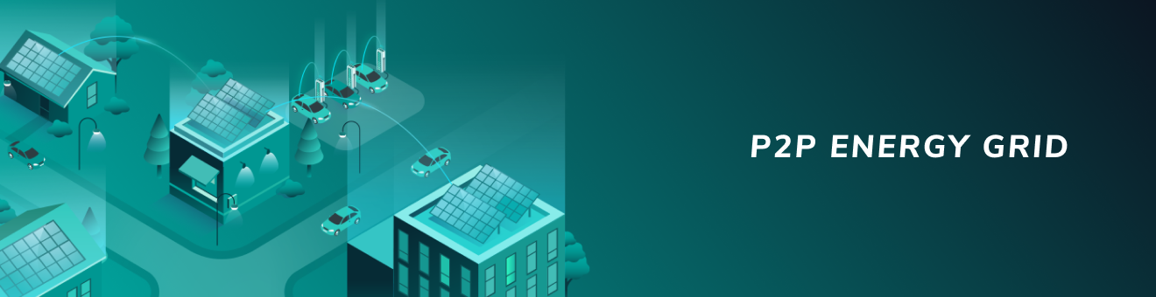
P2P Energy Grid
Energy is shared amongst neighbors and decentralized islands
Automate the transfer of power and payment
Notes:
Although the supply of energy is often automated, the payment system is expensive to integrate and often requires manual intervention. By creating a peer-to-peer (P2P) energy grid with IOTA, you can automate the transfer of power and the payment for that power. This automation makes your infrastructure more dynamic and easier to update.
This blueprint demonstrates how entities in a P2P energy grid can trade energy. The distributed and machine-based nature of the P2P energy grid make this an ideal use case for IOTA. Using IOTA technologies, you can create an infrastructure where even low-powered devices can communicate with the grid in a traceable and immutable way.
Resources for the speaker:
https://docs.iota.org/docs/blueprints/0.1/p2p-energy/overview
https://blog.iota.org/elaadnl-develops-autonomous-self-balancing-power-grid-using-iota-de52e9638548
https://www.youtube.com/watch?v=75oFhRAzgNg

Slide 23
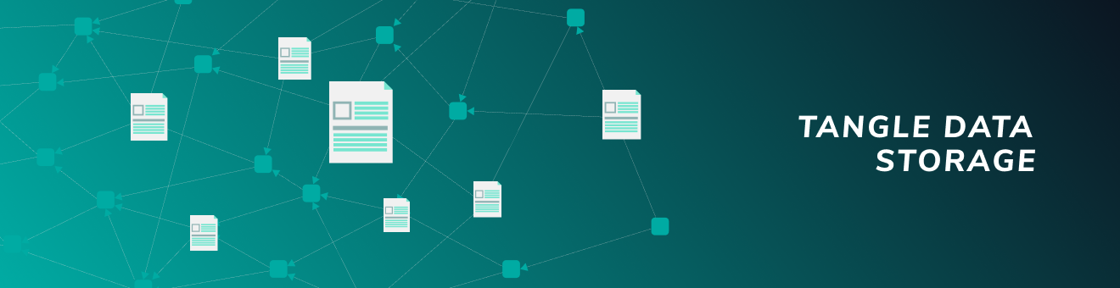
Tangle Data Storage
Store a hash of data and a pointer to its location in third-party data storage
Data to remain private and allow only authorized users to view
Notes:
Data boosts innovation for public and private sector organisations, and can be used to create new revenue streams. However, without a vendor-neutral way of verifying data, it can't be trusted. This blueprint uses the IOTA Tangle as an immutable data structure to verify the contents of a file in a third-party storage solution.
Resources for the speaker:
https://docs.iota.org/docs/blueprints/0.1/tangle-data-storage/overview

Slide 24

Track & Trace
Seamlessly collect and share information about returnable assets
Guaranteed access control of the collected information through MAM
No trust is required among those who run the infrastructure
Notes:
Due to a lack of both due diligence and a vendor-neutral data source, returnable assets that are used within distribution networks are often not returned to their original owners. This blueprint describes how the IBCS Group implemented a track and trace system for recovery of returnable assets, using the IOTA Tangle and other IOTA technologies.
Asset owners can track and request the return of their returnable assets
Asset owners can save the time and the costs associated with searching for missing assets
Asset owners can better predict and plan shipments of their production by knowing the exact number and the exact location of any returnable assets that are available to them
Custodians can track the returnable assets they handle, be rewarded for returning them, and increase their reputation with asset owners
Custodians can save costs associated with supporting requests for returnable assets that are declared missing
Resources for the speaker:
https://docs.iota.org/docs/blueprints/0.1/track-and-trace/overview
https://blog.iota.org/ibcs-group-uses-iota-tangle-technology-for-track-and-trace-supply-chain-solution-4d7cb3c956d1
https://www.youtube.com/watch?v=Gr-LstcDcAw
https://www.youtube.com/watch?v=o5jX8VAyzUs
https://www.youtube.com/watch?v=cZ_q7QRwHcM

Slide 25
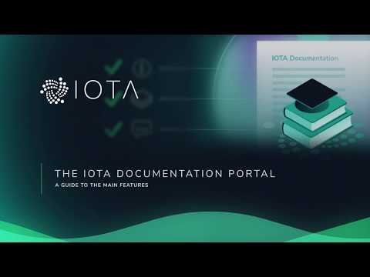
https://youtu.be/mZSG93W1u7A
Notes:
All these resources are available in the IOTA Documentation portal
https://docs.iota.org

Slide 26
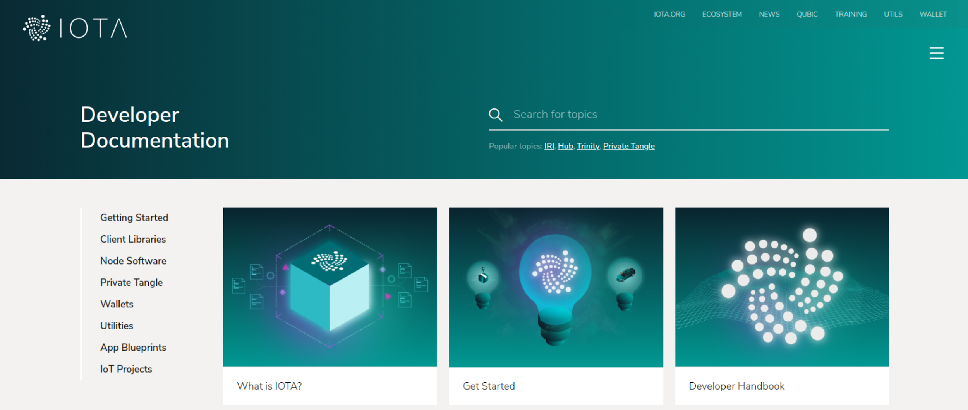
docs.iota.org
Notes:
The IoT Projects and the App Blueprints are available at docs.iota.org

Slide 27





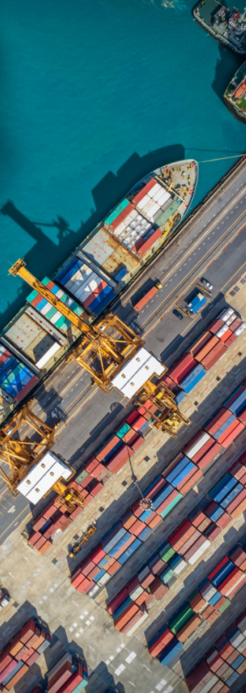
Use-Cases
Telecom
Mobility
Digital Economy
- Payments
- Settlement
- Data Sharing
- Data Integrity
- Identity Management
- Smart Charging
- Over-the-Air Updates
- Car ID & Wallet
- Cars as Autonomous
Economic Agents
- Usage Based Insurance
- Car Paying for Parking
- M2M Economy
- MyData & GDPR
- Biometric Authentication
& Digital ID
- IOTA Data Marketplace
- Smart Factory
- Digital Twin
Smart City
Supply Chain
Social Impact
- Digital ID
- Smart Energy Districts
- P2P Energy Grid
- Cross vertical
- Biometric Identification
- CityxChange Smart
Cities
- Asset Tracking
- Connected Supply Chains
- Global Trade Document Flow
- Product Authenticity and
Provenance
- Ports Management
- New Insurance Models
- Digital ID & Citizen Services
- Humanitarian ID
- Real-time Environmental
Monitoring
- Financial Inclusion
Notes:
Resources for speaker:
https://files.iota.org/comms/IOTA_Use_Cases.pdf

Slide 28

The IOTA Foundation
The IOTA Foundation - to research, develop and grow market adoption of DLT
Non-profit Foundation based and regulated in Berlin, Germany
Growth from 6 to 100+ full time employees distributed across 27 countries
Focused on technical and regulatory challenges of crypto-currencies & DLT
Notes:
Make sure to emphasise that IF's goal is to be irrelevant in 5 years. One of many actors guiding, building, using the Tangle

Slide 29

IOTA Foundation - Vision & Goals

Slide 30

IOTA Ecosystem
Our universe relies on a network of many collaborators
– corporates, academics, governments, NGOs
Notes:
(give examples from Fujitsu, Lidbot, etc..)
Sources for Ecosystem:
http://iota-archive.com/

Slide 31

IOTA Ecosystem
Meet the IOTA Ecosystem
Tutorials
Projects
Events
Developers
Notes:
The IOTA Ecosystem is a hub of education, innovation, tools, collaboration and development for the IOTA distributed ledger protocol and is lead by the IOTA Foundation.
The Ecosystem also is responsible for the Ecosystem Development Fund.
Resources for speaker:
https://ecosystem.iota.org

Slide 32

IOTA Ecosystem Development Fund
Funding for projects in the IOTA Ecosystem
Proof of concepts
Open source utilities and libraries
Educational resources
Media
Philanthropic endeavors
Hackathons
Ideation workshops
Meetups
Notes:
Ecosystem Development Fund Is a collection of donations that are granted to IOTA related projects
Is committed to Transparency, accountability and by memorializing EDF funding agreements with ‘Proof-of-Existence’ transactions on the Tangle, anyone will be able to verify that agreements the EDF enters existed in a certain state at a certain point in time. The IOTA community can thus hold both the EDF and the benefactors of EDF
Resources for speaker:
https://fund.iota.org

Slide 33

Coordicide Grant Program
Research Grant
Optimization of the networking layer to avoid network congestion
Reputation system based on node behavior
Theoretical behavior of cellular automata based consensus
Theoretical properties of query-based voting schemes (e.g., FPC)
https://coordicide.iota.org/grants
Notes:
This project is IOTA’s top priority, and there is the possibility to collaborate through the Coordicide grant program, which offers both large and small grants for research on any aspect of Coordicide.

Slide 34
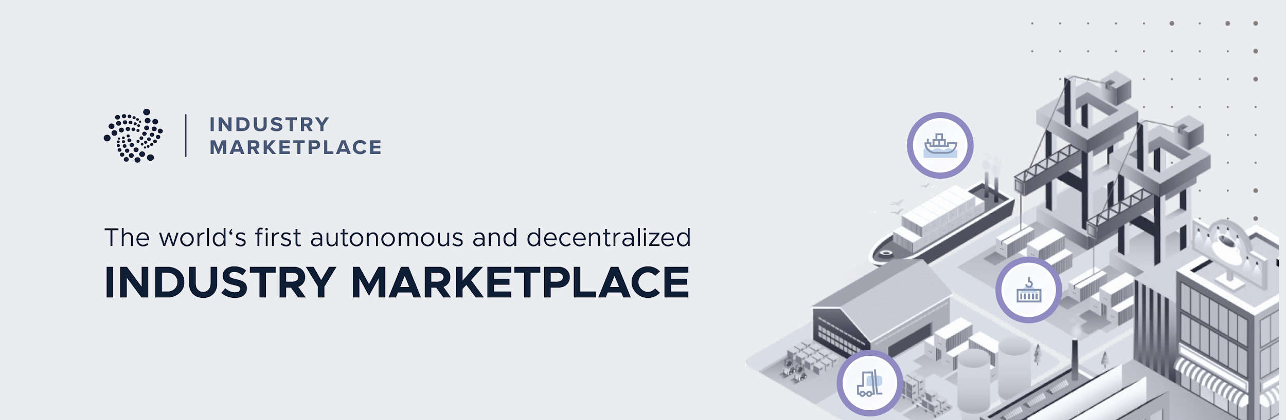





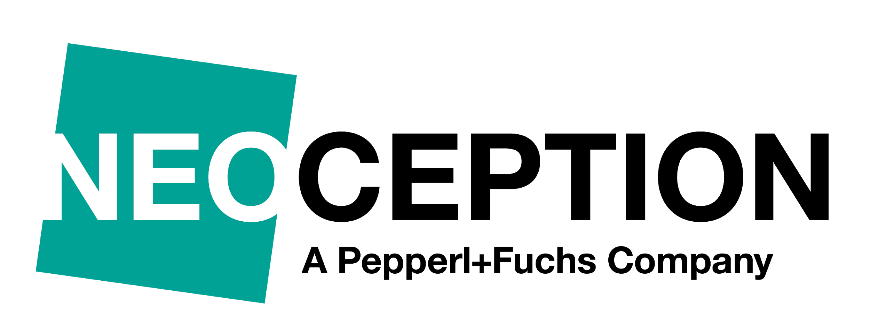
Notes:
The Industry Marketplace is a vendor and industry-neutral platform, automating the trading of physical and digital goods and services.
Building on specifications developed by the Plattform Industrie 4.0 (Germany's central network for the advancement of digital transformation in manufacturing), it combines distributed ledger technology, immutable audit logs and standardized, machine-readable contracts to accelerate industrial automation and enable the "economy of things".
Vendor neutral
Vendor and industry-neutral platform and communication for all participants
Machine Interaction
Standardised communication for contracts, product data, purchasing, bids, orders, services
Semantic language
based on open specifications, developed by Plattform Industrie 4.0 and academic institutes
Decentralized
Decentralized and globally accessible protocol with paramount security
Integrated ID
Decentralized Identity, to ensure the authenticity of all participants
Integrated payment
Payment option for goods and services, without transaction fees
Resources for the speaker:
https://industry.iota.org/use_cases
https://github.com/iotaledger/industry-marketplace/raw/master/Industry_Marketplace_Technical_Documentation.pdf
https://www.youtube.com/watch?v=MHlok4zkKgM
https://www.youtube.com/watch?v=qcLwdCem8mg
https://www.youtube.com/watch?v=o_bkmuqeQjc

Slide 35
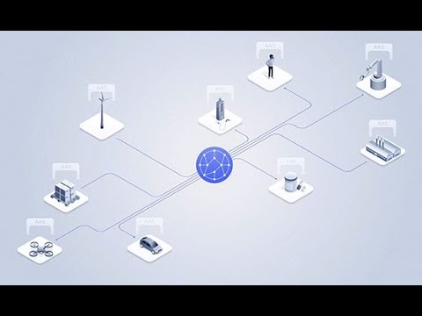
https://youtu.be/Jnh_9nKkemM

Slide 36
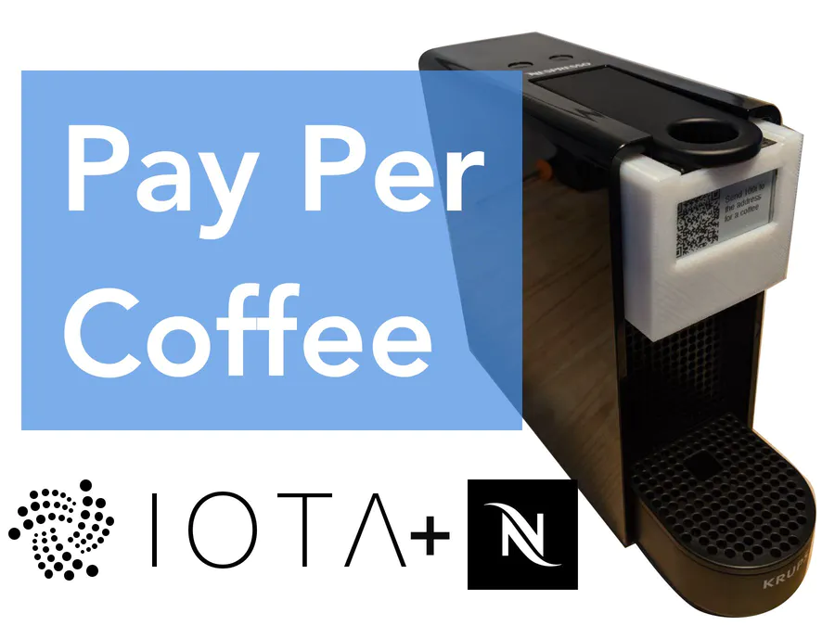

Pay Per Coffee
hackster.io/IOTA
Notes:
https://www.hackster.io/l3wi/pay-per-coffee-a6e55f

Slide 37
Contacts:
Sponsors:
Get involved:
email@provider.com
website.com
twitter.com/myhandle
linkedin.com/in/mylink
<SPONSOR NAME>
<Description>
sponsor.website.com
Website:
Ecosystem:
Discord:
Twitter:
LinkedIn:
YouTube:
www.iota.org
ecosystem.iota.org
discord.iota.org
twitter.com/iotatoken
linkedin.com/company/iotafoundation
www.youtube.com/c/iotafoundation

